Slide 1
Autonomous Drone Delivery System for Industry 4.0
Progress Report
Student Name: Jianhui Li
Supervised by: Dr. Tengyuan Zhang & Prof. Jun Yang
Submission Date: August 10st, 2018

Slide 2
Progress
Test drone guided by Guidance system
Ssuccessfully control the drone by using WIFI SSH
Learning ROS to build a high level control

Slide 3
Objectives
Control the drone to fly to a specific position.
Can remote control the drone and give order from the laptop without wire.

Slide 4
Reading/Literature Review
If you did any reading/literature review in the past two weeks, then:
ROS Crash-Course
DJI guidance SDK
DJI dev@dji.com
http://wiki.ros.org/cn/ROS/Tutorials/UnderstandingNodes

Slide 5
Current Challenges/Discussion
The drone tested last week, but the drone lose control after taking off. The dji service told me to check the IMU and compass. However, it works well in SIMULATOR tools. The code should almost right based on the simulating result. After the new parallel is arrived in the next week, I will find an empty place to test the drone. It is also a little bit dangerous when test the drone. A safety glass is required. The test room should not have any chair, which may cause accidence.

Slide 6
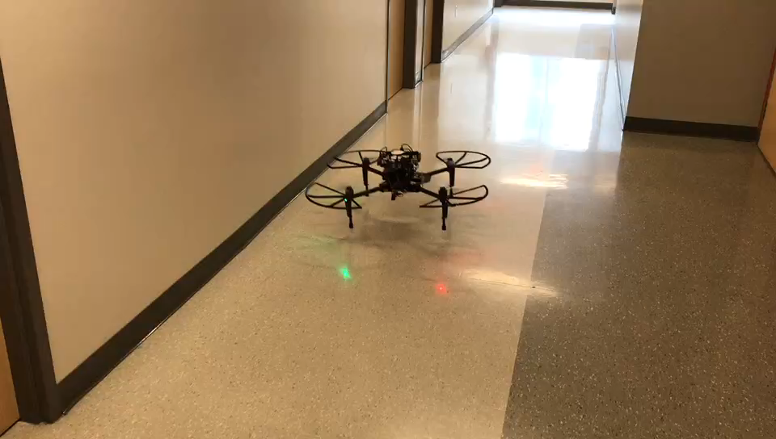
Lab 1: Drone test without claw with guidance system
The drone was tested in the corridor. There are two problems. Firstly, the drone flied backward. Secondly, the drone rotated about 90 degree after taking off. These abnormal movement have never showed in DJI SIMULATOR. The first problem is solved. The drone need more time to finish taking-off function. The SDK-API just supports a function for the drone to take off, but the user need to give the drone about 5 seconds. Using sleep(5000000) can solve this problem. The second problem is considered to solved by calibrate compass and IMU.

Slide 7
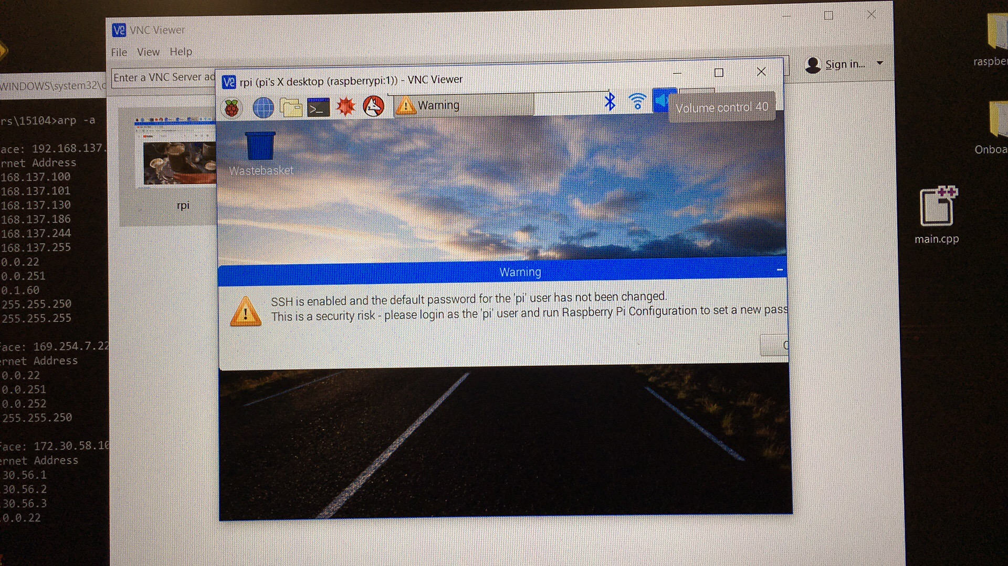
Lab 2: control the raspberry pi by using wifi, and show the desktop of RPI
Using VNC VIEWER, we can see the raspiberry pi’s desktop. The wifi-SSH have two advantages. First, we can do digital picture processing by checking how it works in raspberry-pi, and we don’t need to buy another special screen for the RPI. Second, we can send order to raspberry pi without the wire connection, which means we can send order to the drone at any time, even though the drone is flying.

Slide 8
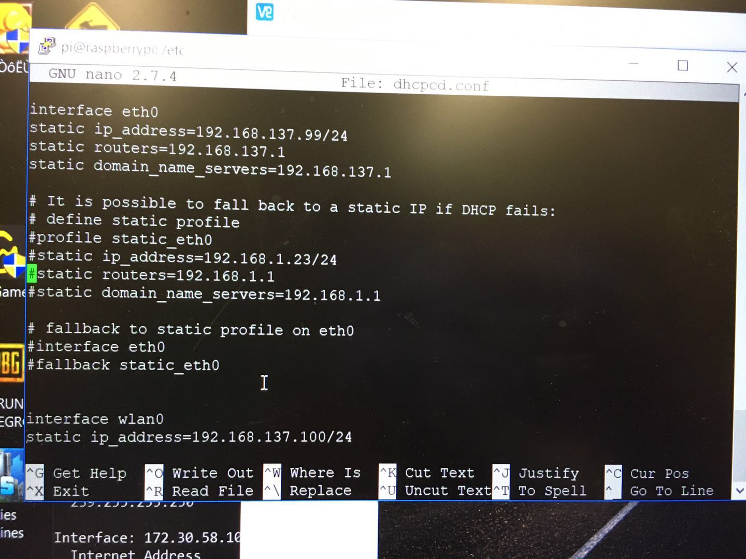
Lab 3: fix the IP address. (keep the static IP)
In the past, the raspberry pi’s IP address changed every one day. And I have to set the network sharing setting everyday. It may damage the system file sometimes. Right now, I keep two static IP. The Ethernet address is 192.168.137.99. The wifi address is 192.168.137.100. It is convenient for other people to use raspberry pi on their own laptop.
By using
sudo nano /etc/dhcpcd.conf
Change the wifi and eth0 IP.
Check your own laptop static routers before you change the IP

Slide 9
Summary
dev@dji.com confirm that the code is right. I’m confident to solve the problem in the next week. The drone should implement the idea flying from one point to another point. And also there is a new way to control the drone without cable connection, which can be used to check the situation during flying

Slide 10
Future Plan
In the next week, the drone will be tested after the new drone arrived. And I need to make a “read me” file for the future research about the drone deliver system.

